Slide 1




The United Kingdom of
Great Britain and Northern Ireland
Union Flag or Union Jack
The current design of the flag dates from the union of
Ireland and Great Britain in 1801.
It consists of three flags
Saint Patrick's Saltire
or Saint Patrick's Cross
Scotland
Saint Andrew's Cross
England
St George's Cross

Slide 2
Scotland
Saint Andrew's Cross
According to legend, in 832 A.D. Óengus II (Ангус II ) led an army of Picts and Scots into battle against the Angles. Не prayed on the eve of battle and promised that if granted victory he would appoint Saint Andrew as the Patron Saint of Scotland. On the morning of battle white clouds, forming an X shape in the sky
A.D. Anno Domini – н.э. (от рождества Христова)
to iead (led-led) -?
Picts- пикты
Scots – скотты
Angles – англы
to pray –молиться
to promise – обещать
to appoint – назначать, зд. Объявлять
shape – форма
patron - покровитель

Slide 3
England
St George's Cross
Saint George was the patron saint of England.
At the beginning of the Crusades the Pope decided
that English crusaders would be distinguished by wearing
a white cross on red. In January 1188 the French King, Philip II English King Henry II agreed to exchange flags.
crusades - Крестовые походы
the Pope – Папа
To distinguish – различать, отличать

Slide 4
Saint Patrick's Saltire
or Saint Patrick's Cross
Saint Patrick, the patron saint of Ireland.
The origin of the flag is unclear.

Slide 5
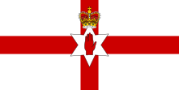
Northern Ireland
Ulster Banner
Ольстерское знамя
The official flag of the United Kingdom of Great Britain
and Northern Ireland is the only flag used by
the government in Northern Ireland.

Slide 6
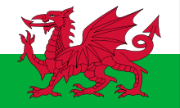
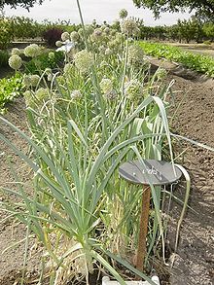
Wales
The Red Dragon
The green and white stripes of the flag were additions by
the House of Tudor, the Welsh dynasty that held the English throne from 1485 to 1603.
Green and white are also the colours of the leek,
another national emblem of Wales.
Tudor - Тюдор

Slide 7

the United States of America
The 50 stars on the flag represent the 50 states of the United States of America and the 13 stripes represent the thirteen British colonies
that declared independence from the Kingdom of Great Britain
and became the first states in the Union.
represent – представлять собой
stripe - полоса

Slide 8

Canada
Maple Leaf
On February 15, 1965 Canada adopted the red and white flag with one maple leaf as it's official flag.
Historically Canada is linked with England and France. Hence red and white coloures are on the flag (coloures of England and France).
Maple leaf trees were used for the maple syrup and sugar export.
adopted – принят
hence – отсюда, поэтому

Slide 9

Australia
Australian flag represents a blue field which contains the Union Flag, the Commonwealth Star ,a representation of the Southern Cross constellation, made up of five white stars – one small five-pointed star and four, larger, seven-pointed stars.
The Commonwealth Star (звезда Содружества) has seven points. Six points represent the six original states of the Commonwealth of Australia, the seventh point represents the territories and any other future states of Australia.
contain - содержать
Southern Cross constellation – созвездие Южный Крест
point – зд. луч

Slide 10

New Zealand
New Zealand flag represents a blue field which contains the Union Flag and the brightest stars of the Southern Cross constellation.
bright - яркий

