Slide 1
Hero (male)
(heroine – female heroes – pl)
Definition of hero noun from the Oxford Advanced Learner's Dictionary
1. A person who is admired by many people for doing something brave or good (a war hero,
a mythological hero).
2. The main character in a story, novel, film, etc.
3. A person that you admire because of a particular quality or skill that they have. to admire – восхищаться main – главный particular – особый quality - качество

Slide 2
Traits / features
(of character)
  Noun(сущ.)
  Strength (physical,moral)
  Bravery
Courage
Selflessness
Kindness
  Adjective (прил.)
  Strong
  Brave
Courageous
Selfless
Kind

Slide 3
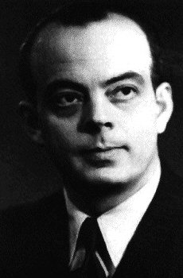
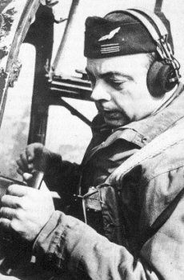
Antoine de Saint-Exupéry
A French writer, poet and aviator
He is best remembered for his novella
The Little Prince
To remember - помнить

Slide 4
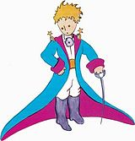
Quotes and Pictures
The author made
the illustrations
himself
“This is his best portrait.”
Chapter II

Slide 5
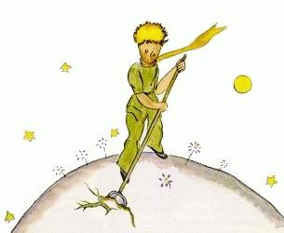
Quotes and Pictures
“When you've finished getting yourself ready in the morning, you must go get the planet ready.”
Chapter V
«Привёл в порядок …»

Slide 6
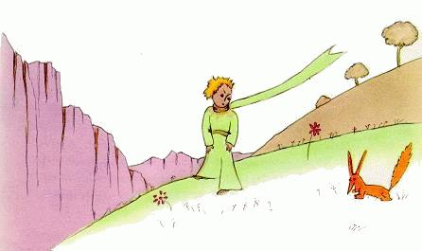
Quotes and Pictures
You become responsible, forever,
for what you have tamed.«
Chapter XXI
«Ты навсегда в ответе за…»
to tame - приручать

Slide 7
Quotes and Pictures
“To be a man is, precisely,
to be responsible.”
Antoine de Saint-Exupéry

Slide 8
My hero is the Little Prince, a character from the book of Antoine de Saint-Exupéry.
He is very kind and responsible.
In my opinion he can be called a hero because he helps flowers, trees, animals and takes care of the planet on the whole. A person should be a brave and strong to make good deeds every day!

Slide 9
1. Who is your hero?
2. What kind of person is he/she?
3. Why can he/she be called a hero?
1. M y hero is …
2. H e is …
3. I consider / think / in my opinion he/she is a hero/heroine because …

